Slide 1
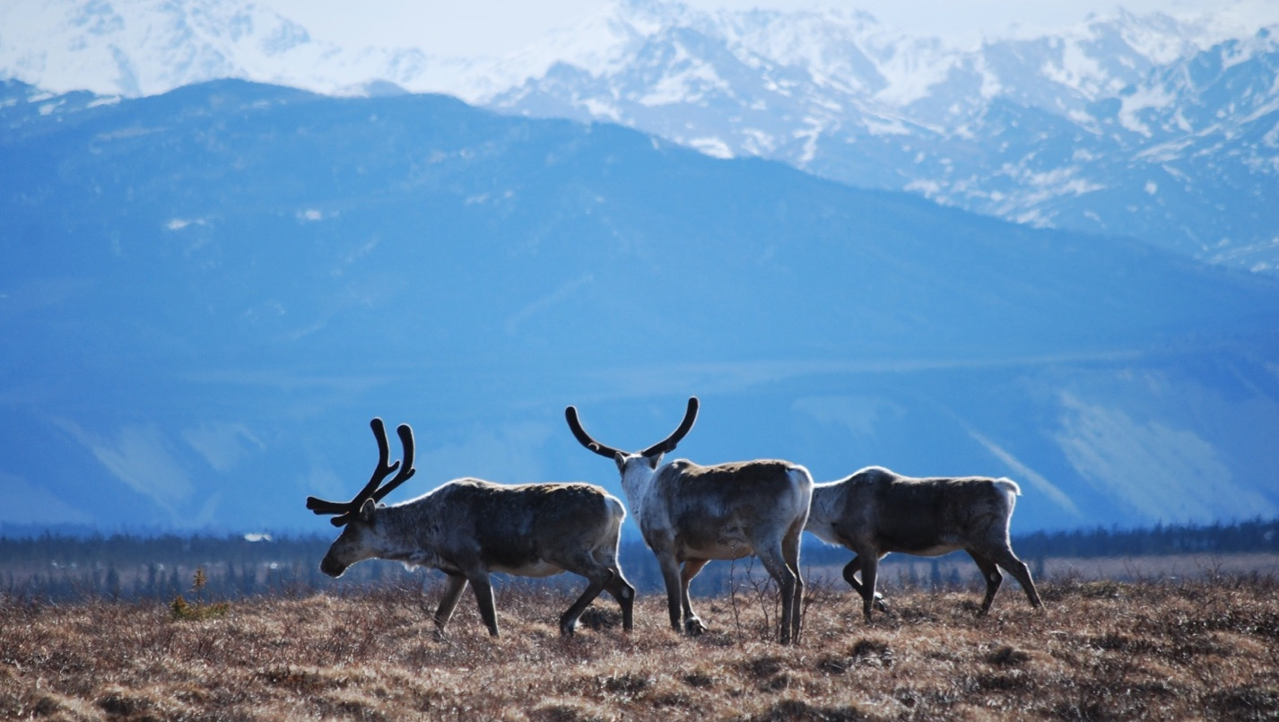
Arctic Boreal Vulnerability Experiment (ABoVE)
2019 ABoVE Airborne Flights
9 July 2019 (DOY 190)
AVIRIS-NG: Seward Peninsula Revisit
Charles Miller, Deputy Science Lead
Jet Propulsion Laboratory, California Institute of Technology
and the ABoVE Science Team For Hank Margolis, Mike Falkowski, Bruce Tagg, Jack Kaye
NASA HQ
2019

Slide 2
9 July 2019/DOY 190 Seward Peninsula Revisit
Daily Status:
AVIRIS-NG / Dynamic Aviation B-200 (N53W)
REPORT DATE: 9 July 2019
Current Status of Aircraft: GREEN
Current Status of AVIRIS: GREEN
Current Deployment Location: Fairbanks AK (PAFA)
Crew: S Wilson (PIC), C McCann, M Helmlinger, J Chapman
Science Planning: A Thorpe
Data Processing: W Olsen-Duvall
Instrument Manager: M Eastwood
Instrument PI: R Green
Science Lead: C Miller

Slide 3
9 July 2019/DOY 190 Seward Peninsula Revisit
Daily Summary:
Severe clear over the Seward Peninsula and Noatak Delta
NGEE-Arctic team in the field at Seward Peninsula sites obtaining simultaneous ground truth spectra and vegetation data
Map 2x to capture reproducibility and diurnal variability
First pass 1230-1330 AKDT
Second pass 1630 – 1750 AKDT

Slide 4
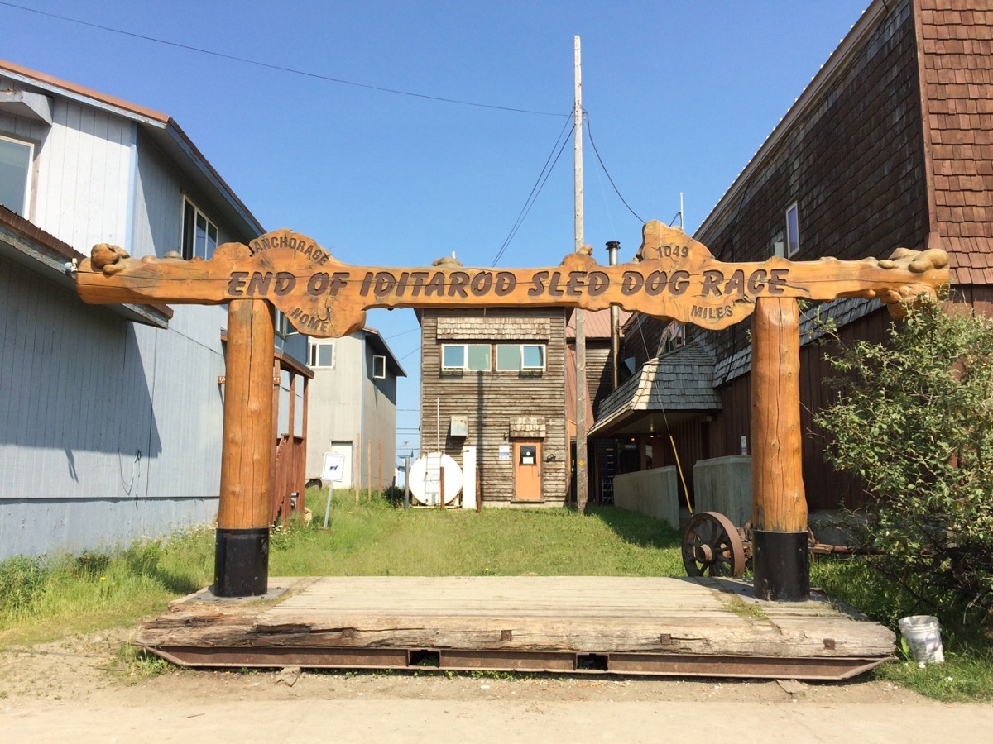
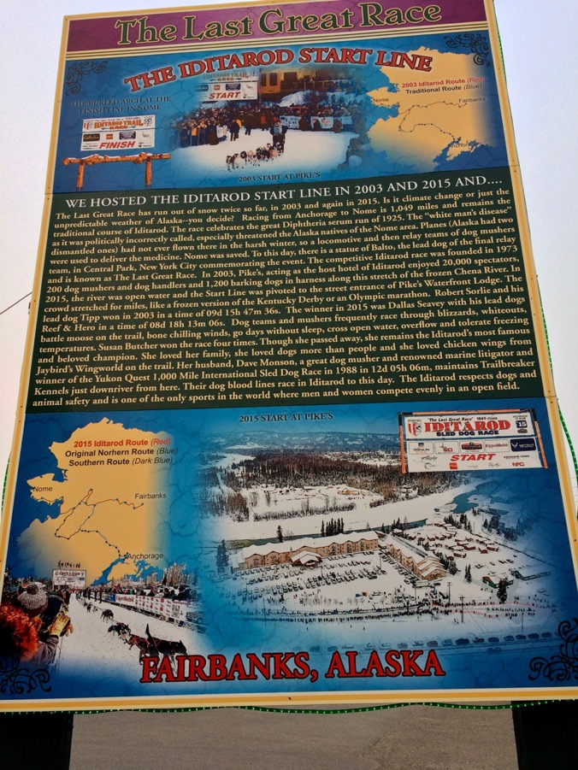
9 July 2019/DOY 190 Seward Peninsula Revisit

Slide 5
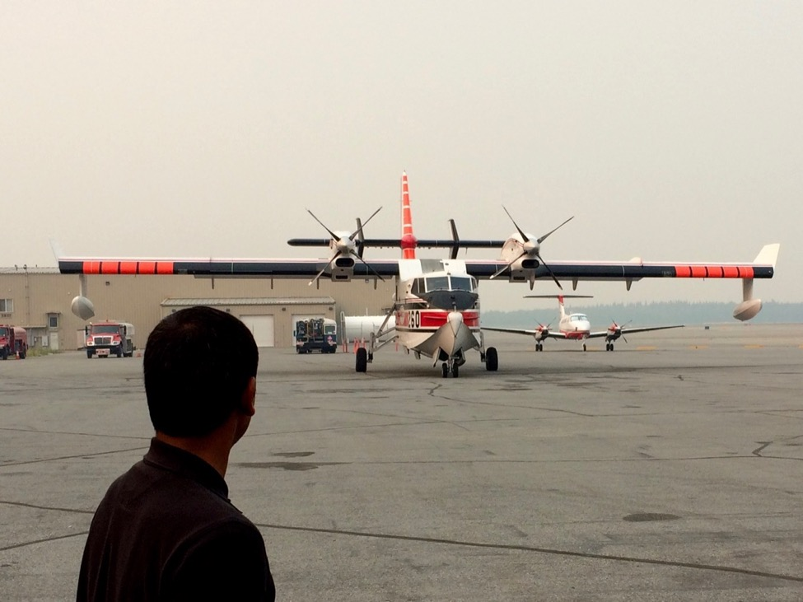
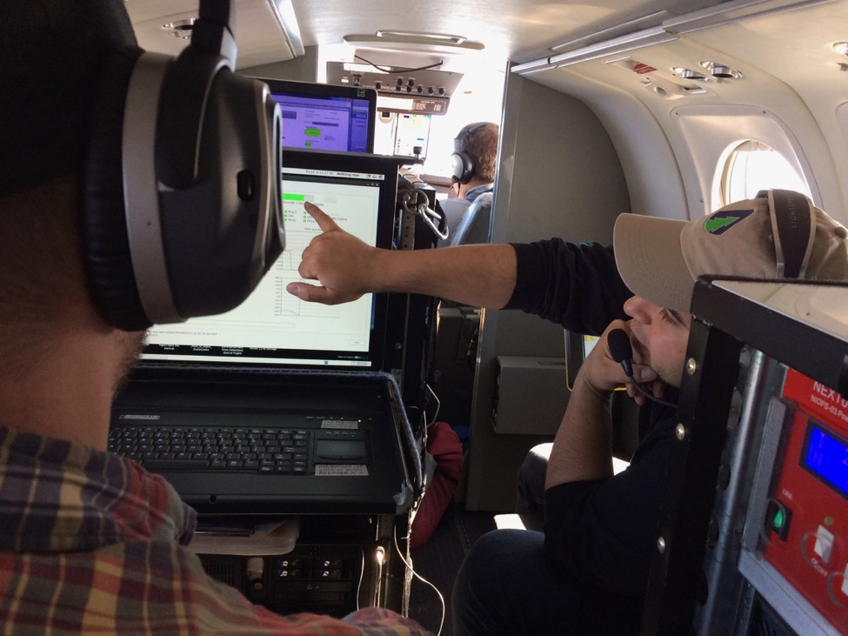
9 July 2019/DOY 190 Seward Peninsula Revisit

Slide 6
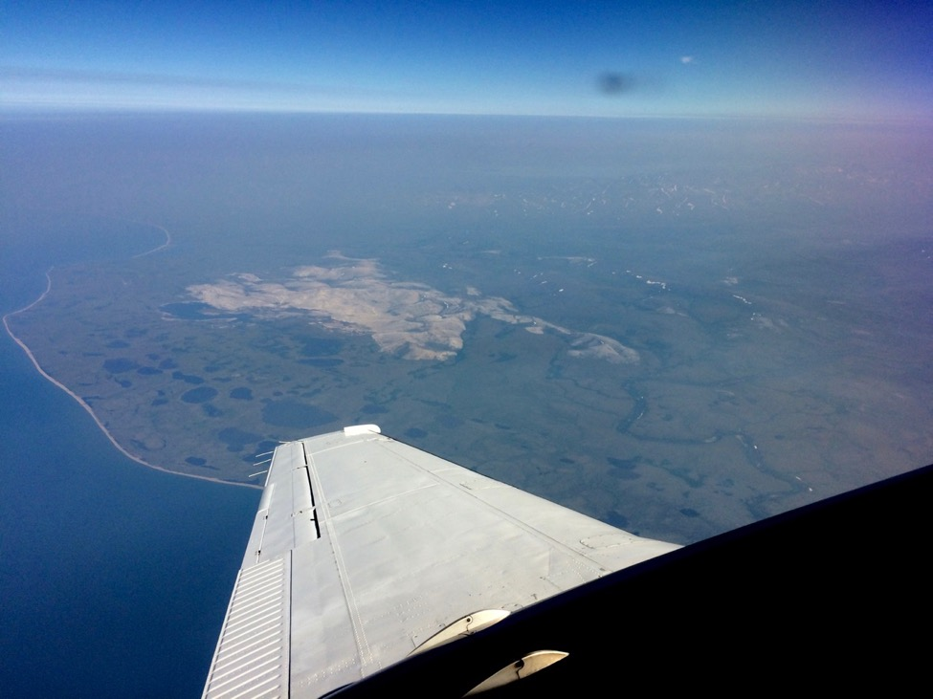
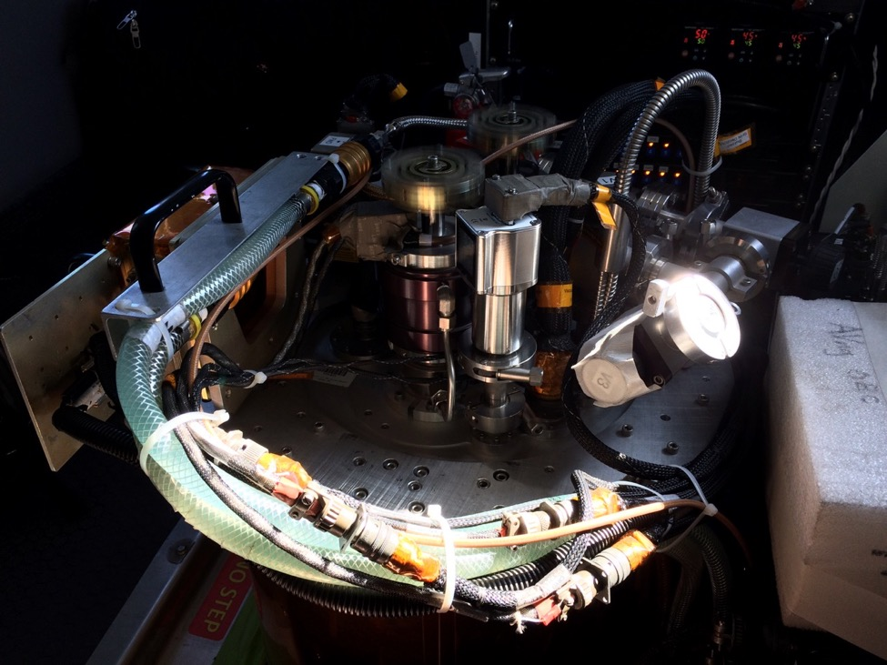
9 July 2019/DOY 190 Seward Peninsula Revisit

Slide 7
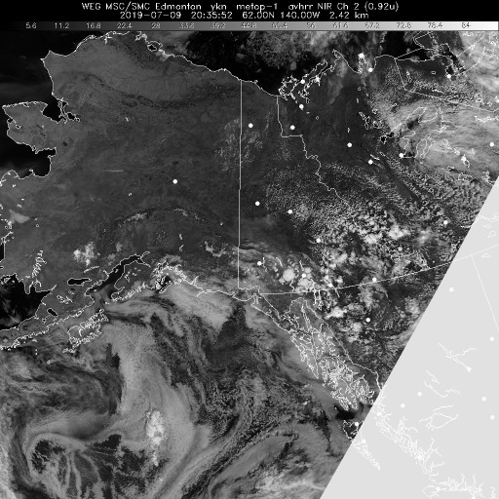
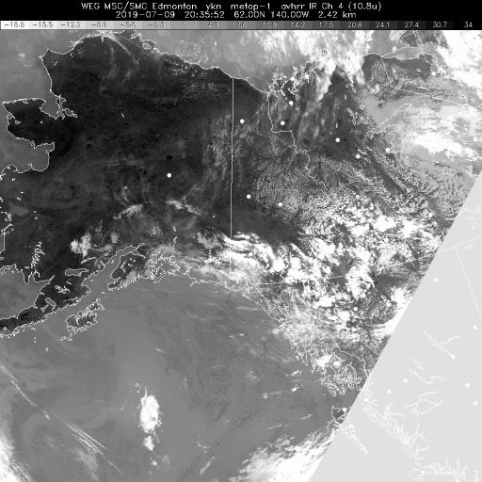
9 July 2019/DOY 190 Seward Peninsula Revisit
Leg 1
Vis 2035Z
IR2035Z
Notes:
No clouds or fog at all

Slide 8
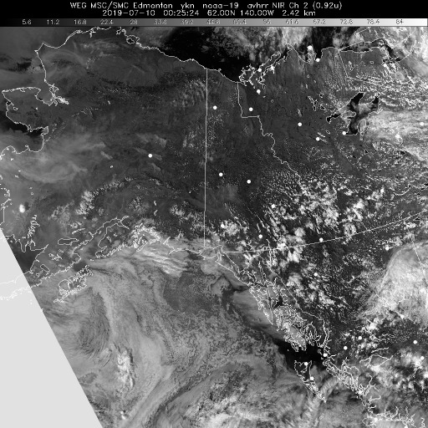
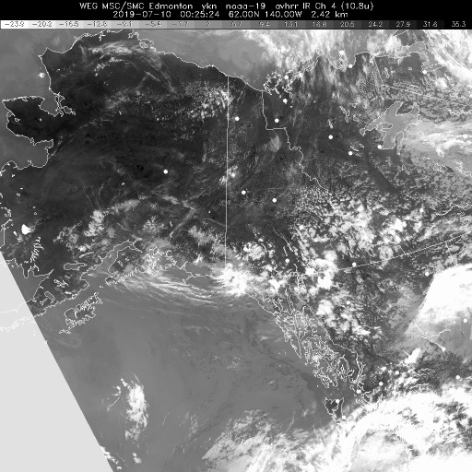
9 July 2019/DOY 190 Seward Peninsula Revisit
Leg 2
Vis 0025Z
IR 0025Z
Notes:
Vis shows suggestions of light atmospheric interference; IR stays clear

Slide 9
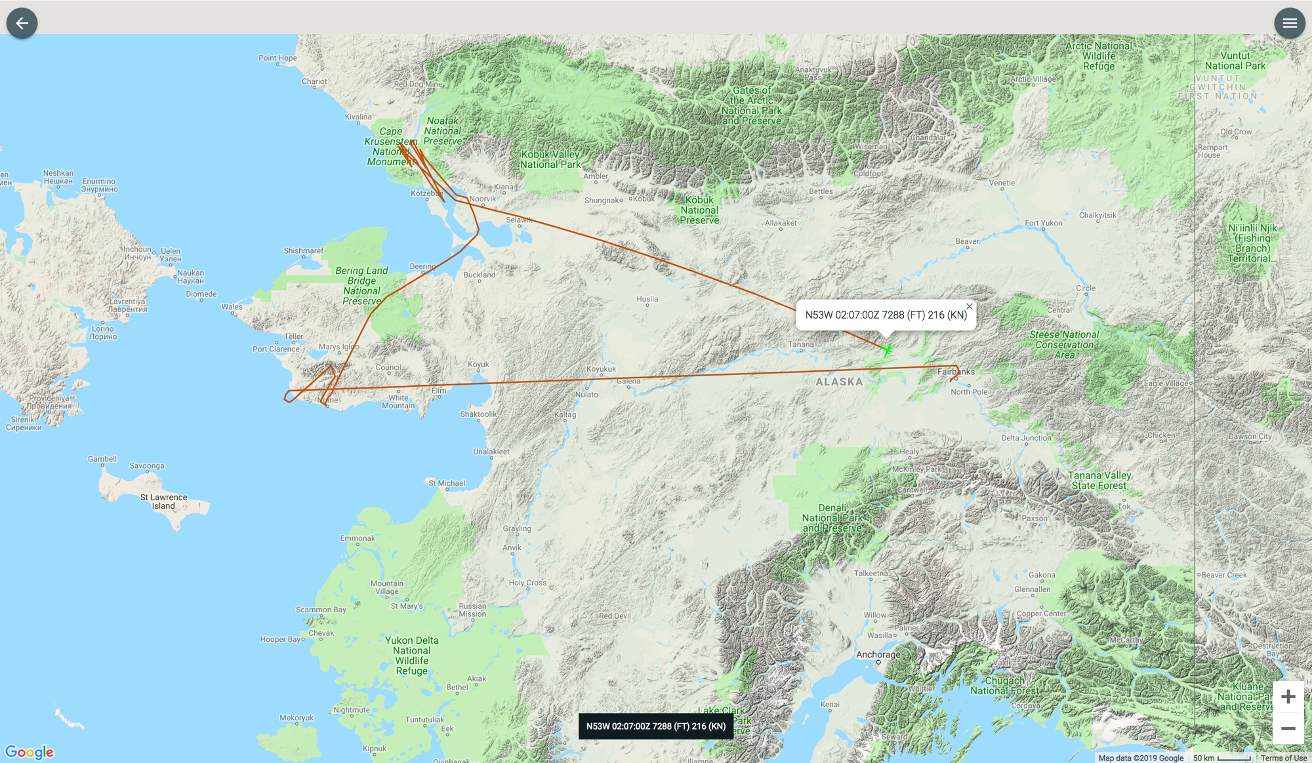
7 July 2019/DOY 188 Seward Peninsula – Noatak
Leg 2
As-Flown Lines
Leg 1

Slide 10
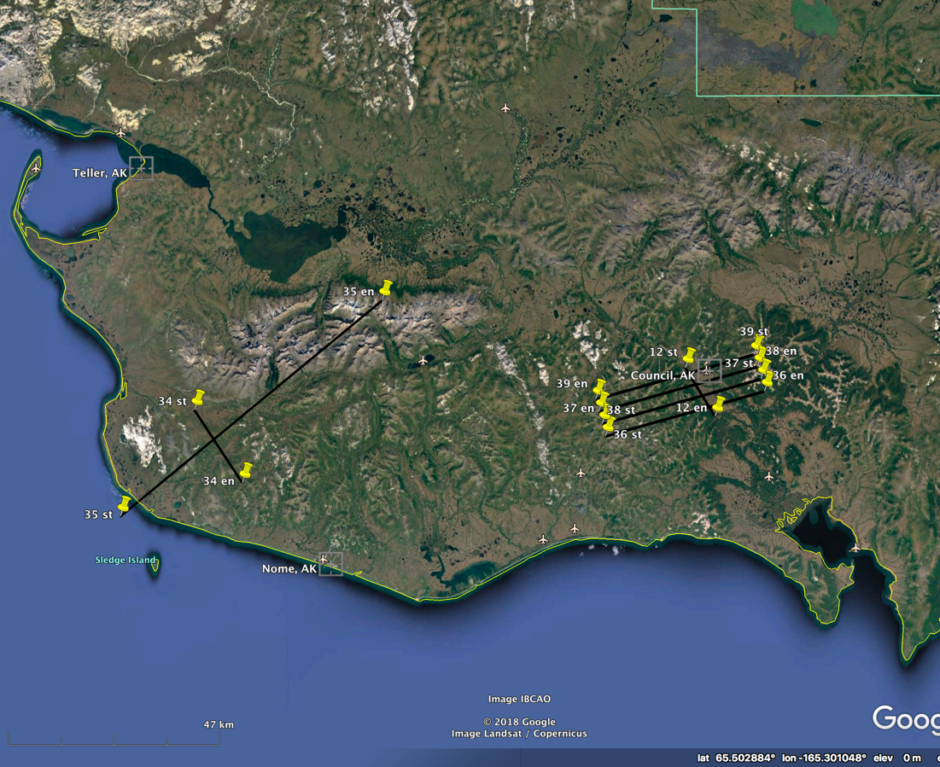
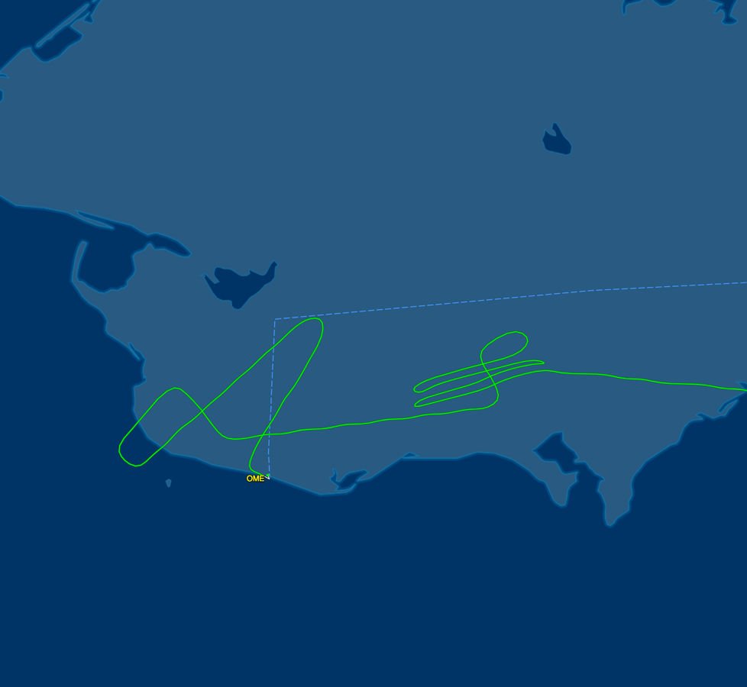
9 July 2019/DOY 190 Seward Peninsula Revisit
Seward Peninsula
Planned Flight Lines
Seward Peninsula Area
As-Flown Lines

Slide 11
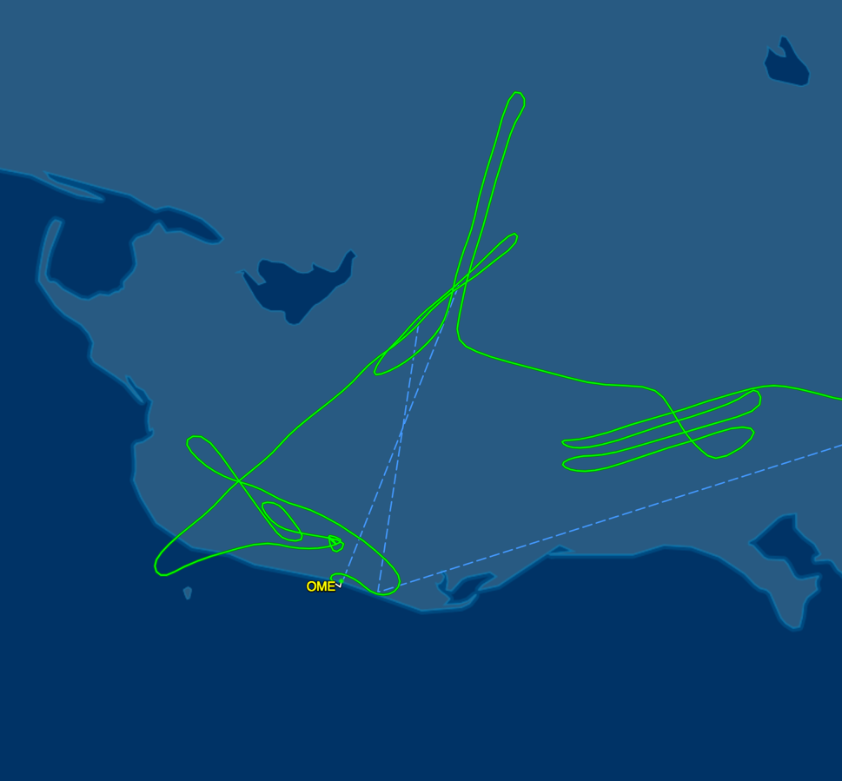
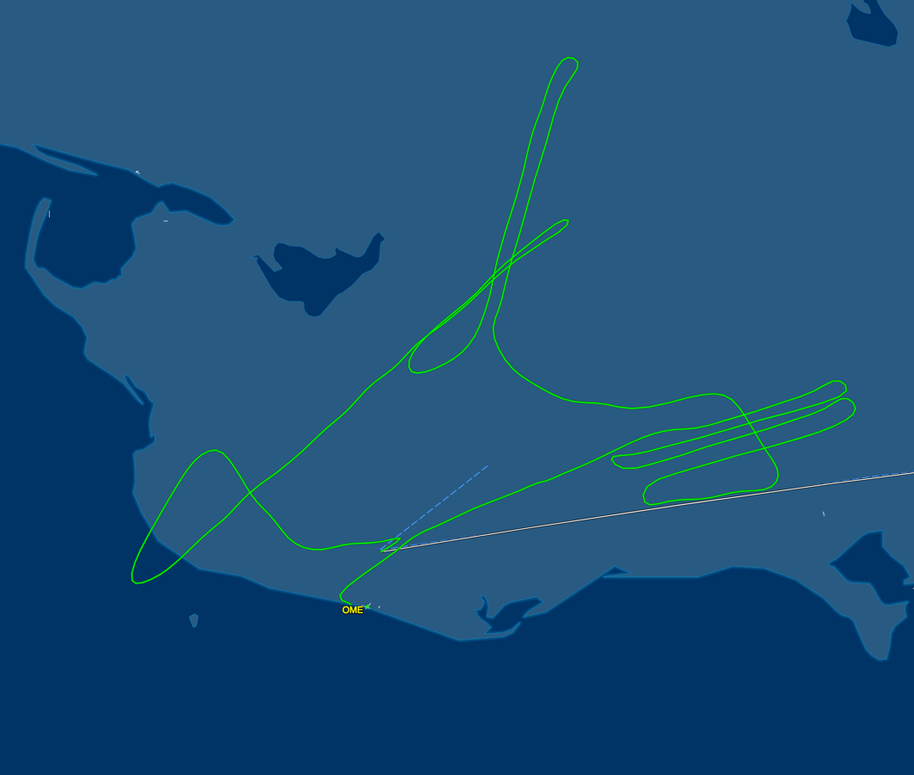
9 July 2019/DOY 190 Seward Peninsula Revisit
Leg 1
As-Flown Lines
Leg 2
As-Flown Lines

Slide 12
9 July 2019/DOY 190 Seward Peninsula Revisit
AVIRIS-NG Quick-look products
https://avirisng.jpl.nasa.gov/cgi/flights.cgi?step=view_flightlog&flight_id=ang20190709t
A. Line NGEE_L004_FL188 , ang20190709t193940_geo : Council grid
B. Line NGEE_L003_FL188 , ang20190709t194829_geo : Council grid
A
B
A. Looks good despite haze; Council and airstrip seen in middle of page
B. Nice
Notes:
7/19/19 Review
GREEN; Flight Log – clear above, hazy below
GREEN; Flight Log – clear above, hazy below

Slide 13
9 July 2019/DOY 190 Seward Peninsula Revisit
AVIRIS-NG Quick-look products
https://avirisng.jpl.nasa.gov/cgi/flights.cgi?step=view_flightlog&flight_id=ang20190709t
A. Line NGEE_L002_FL188 , ang20190709t195734_geo: Council grid
B. Line NGEE_L001_FL188 , ang20190709t200636_geo: Council grid
A
B
A. Looks good despite haze; Council and airstrip seen in middle of page
B. Nice
Notes:
7/19/19 Review
GREEN; Flight Log – clear above, hazy below
GREEN; Flight Log – clear above, hazy below

Slide 14
9 July 2019/DOY 190 Seward Peninsula Revisit
AVIRIS-NG Quick-look products
https://avirisng.jpl.nasa.gov/cgi/flights.cgi?step=view_flightlog&flight_id=ang20190709t
A. Line AVng_347A-347Z_FL176 , ang20190709t201645_geo : Council flux tower, CALM
B. Line Kougarok_L003_FL182 , ang20190709t202721_geo : Kougarok Road grid
A
B
A. Looks good despite haze; Council and airstrip seen in middle of page
B. Kougarok Road and airstrip imaged nicely
Notes:
7/19/19 Review
GREEN; Flight Log – clear above, hazy below
GREEN; Flight Log – clear above, hazy below

Slide 15
9 July 2019/DOY 190 Seward Peninsula Revisit
AVIRIS-NG Quick-look products
https://avirisng.jpl.nasa.gov/cgi/flights.cgi?step=view_flightlog&flight_id=ang20190709t
A. Line Kougarok_L002_FL182 , ang20190709t203755_geo : Kougarok Road grid
B. Line Kougarok_L001_FL182 , ang20190709t205007_geo : Kougarok Road grid
A
B
A. Nice
B. Nice image
Notes:
7/19/19 Review
GREEN; Flight Log – clear above, hazy below
GREEN; Flight Log – clear above, hazy below

Slide 16
9 July 2019/DOY 190 Seward Peninsula Revisit
AVIRIS-NG Quick-look products
https://avirisng.jpl.nasa.gov/cgi/flights.cgi?step=view_flightlog&flight_id=ang20190709t
A. Line AVng_344A-344Z_FL184 , ang20190709t205928_geo : Teller – Kougarok transect
B. Line AVng_343A-343Z_FL179 , ang20190709t213747_geo : Teller Watershed
A
B
A. Norton Sound – Teller – Kougarok watershed
B. Gorgeous image
Notes:
7/19/19 Review
GREEN; Flight Log – clear above, hazy below
GREEN; Flight Log – clear above, hazy below

Slide 17
9 July 2019/DOY 190 Seward Peninsula Revisit
AVIRIS-NG Quick-look products
https://avirisng.jpl.nasa.gov/cgi/flights.cgi?step=view_flightlog&flight_id=ang20190709t
A. Line NGEE_L004_FL188 , ang20190710t003005_geo : Council grid
B. Line NGEE_L003_FL188 , ang20190710t003915_geo : Council grid
A
B
A. Looks good despite haze; Council and airstrip seen in middle of page
B. Nice
Notes:
7/19/19 Review
GREEN; Flight Log – clear above, hazy below
GREEN; Flight Log – clear above, hazy below

Slide 18
9 July 2019/DOY 190 Seward Peninsula Revisit
AVIRIS-NG Quick-look products
https://avirisng.jpl.nasa.gov/cgi/flights.cgi?step=view_flightlog&flight_id=ang20190709t
A. Line NGEE_L002_FL188 , ang20190710t004802_geo : Council grid
B. Line NGEE_L001_FL188 , ang20190710t005719_geo : Council grid
A
B
A. Looks good despite haze; Council and airstrip seen in middle of page
B. Nice
Notes:
7/19/19 Review
GREEN; Flight Log – clear above, hazy below
GREEN; Flight Log – clear above, hazy below

Slide 19
9 July 2019/DOY 190 Seward Peninsula Revisit
AVIRIS-NG Quick-look products
https://avirisng.jpl.nasa.gov/cgi/flights.cgi?step=view_flightlog&flight_id=ang20190709t
A. Line AVng_347A-347Z_FL176 , ang20190710t010938_geo : Council flux tower, CALM
B. Line Kougarok_L003_FL182 , ang20190710t012039_geo : Kougarok Road grid
A
B
A. Looks good despite haze; Council and airstrip seen in middle of page
B. Kougarok Road and airstrip imaged nicely; haze observed on right hand side of image – as it goes into the valley
Notes:
7/19/19 Review
GREEN; Flight Log – clear above, hazy below
GREEN/Yellow; Flight Log – clear above, hazy below

Slide 20
9 July 2019/DOY 190 Seward Peninsula Revisit
AVIRIS-NG Quick-look products
https://avirisng.jpl.nasa.gov/cgi/flights.cgi?step=view_flightlog&flight_id=ang20190709t
A. Line Kougarok_L002_FL182 , ang20190710t013115_geo : Kougarok Road grid
B. Line Kougarok_L001_FL182 , ang20190710t014346_geo : Kougarok Road grid
A
B
A. Nice near hills, but haze observed on right hand side of image as it goes into the valley
B. Nice image
Notes:
7/19/19 Review
GREEN/YELLOW; Flight Log – clear above, hazy below
GREEN; Flight Log – clear above, hazy below

Slide 21
9 July 2019/DOY 190 Seward Peninsula Revisit
AVIRIS-NG Quick-look products
https://avirisng.jpl.nasa.gov/cgi/flights.cgi?step=view_flightlog&flight_id=ang20190709t
A. Line AVng_344A-344Z_FL184 , ang20190710t015246_geo : Teller – Kougarok transect
B. Line AVng_343A-343Z_FL179 , ang20190710t021538_geo : Teller Watershed
A
B
A. Norton Sound – Teller – Kougarok watershed
B. Nice image, some haze near left?
Notes:
7/19/19 Review
GREEN; Flight Log – clear above, hazy below
GREEN/Yellow; Flight Log – clear above, hazy below

Slide 22
Backup

Slide 23
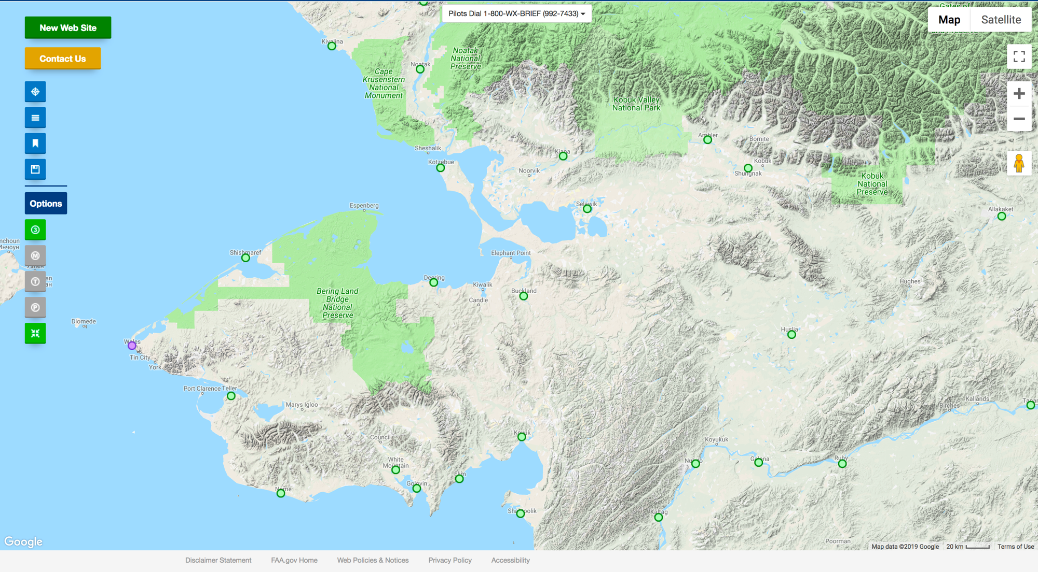
FAA Camera Locations

Slide 24
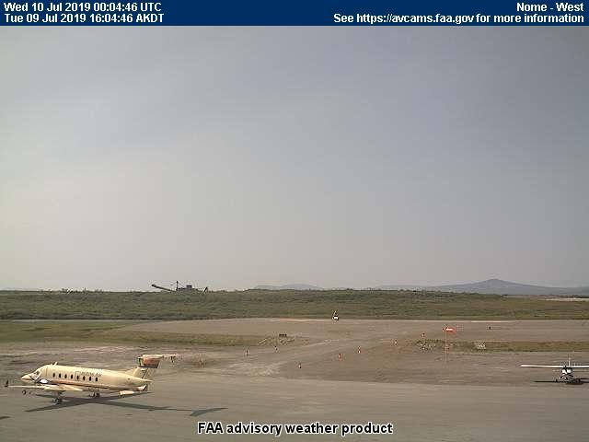
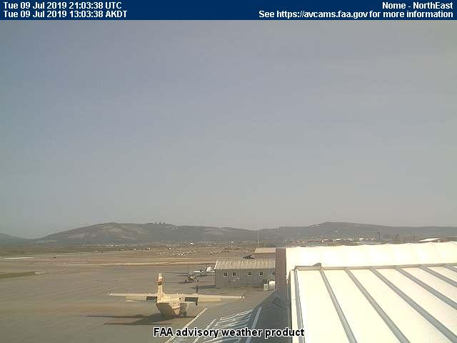
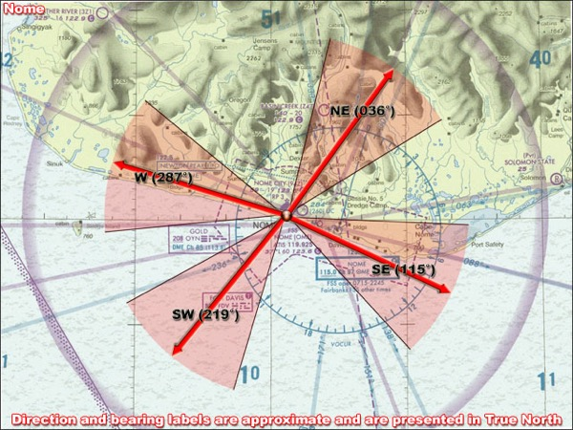
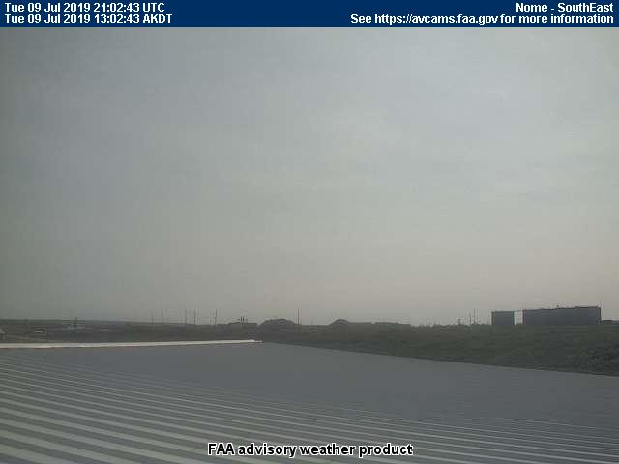
9 July 2019/DOY 190 Seward Peninsula Revisit
Leg 1
Update
Nome (POME) – 1300 AKDT/2100 UTC
West
Northeast
Southwest
Southeast

Slide 25
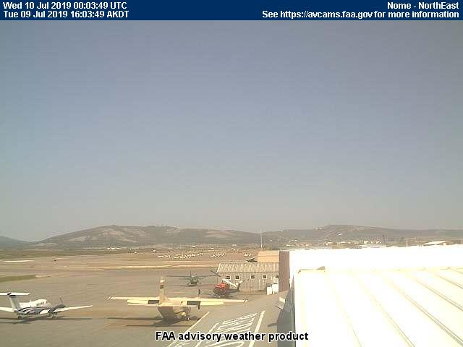
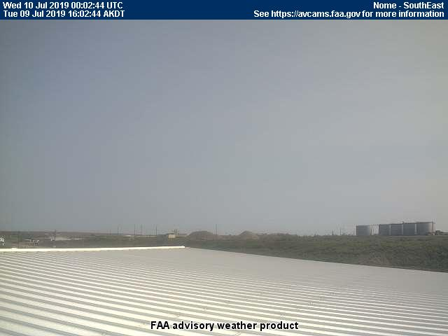
9 July 2019/DOY 190 Seward Peninsula Revisit
Leg 2
Nome (POME) – 1604 AKDT/0004 UTC
West
Northeast
Southwest
Southeast
Notes:
Haze noticeable in the late afternoon images

Slide 26
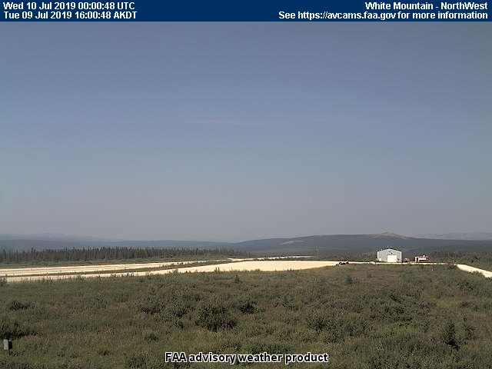
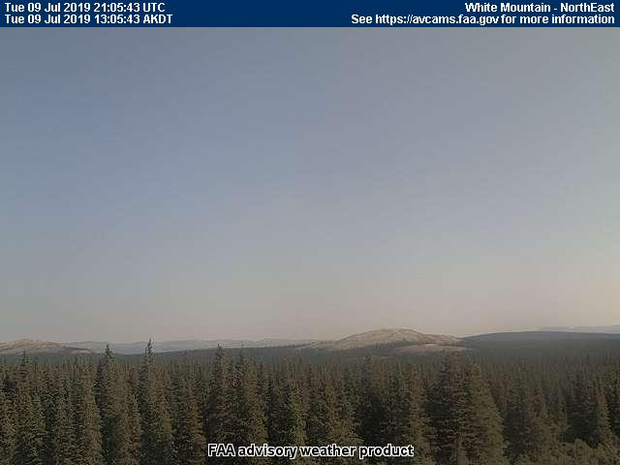
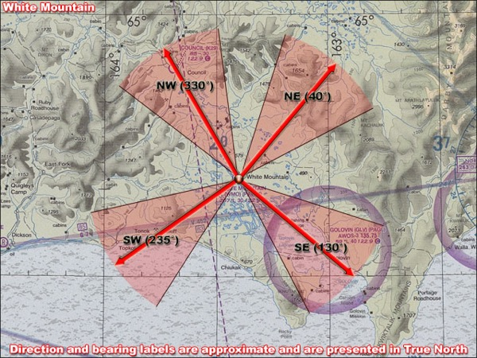
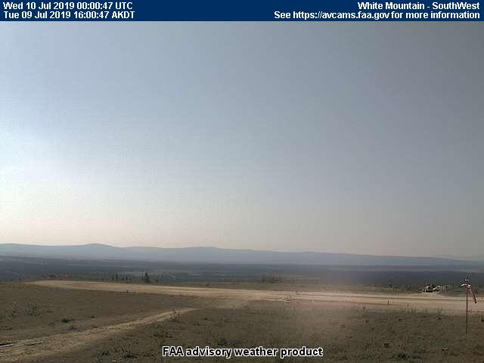
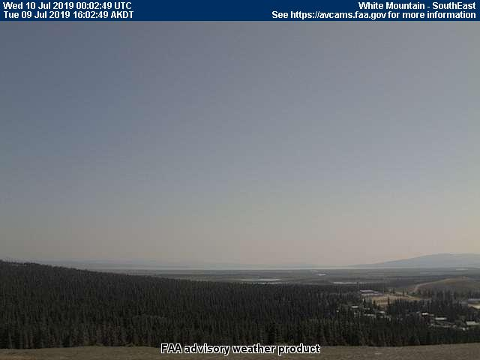
9 July 2019/DOY 190 Seward Peninsula Revisit
Leg 1
Update
White Mountain – 1305 AKDT/2105 UTC
Northwest
Northeast
Southwest
Southeast

Slide 27
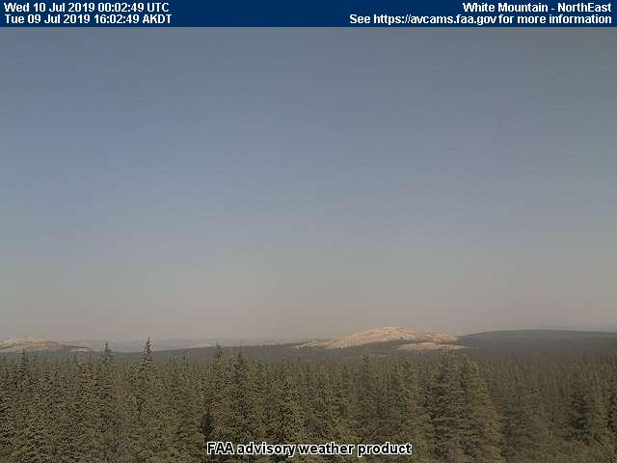
9 July 2019/DOY 190 Seward Peninsula Revisit
Leg 2
White Mountain – 1600 AKDT/0000 UTC
Northwest
Northeast
Southwest
Southeast

Slide 28
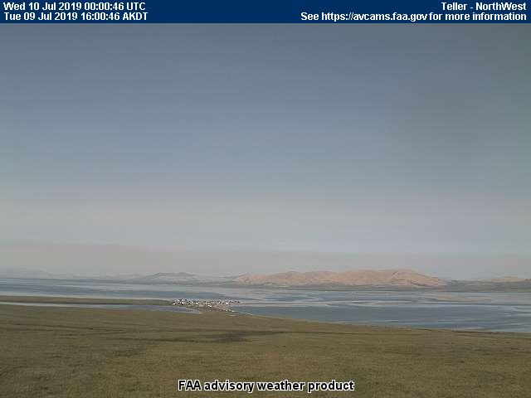
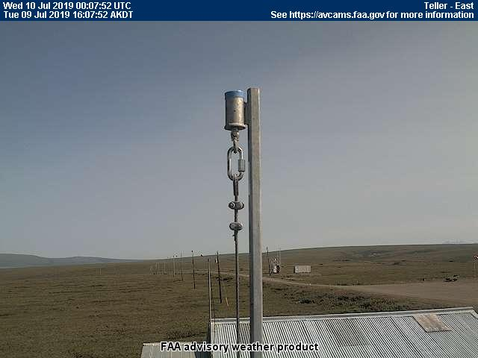
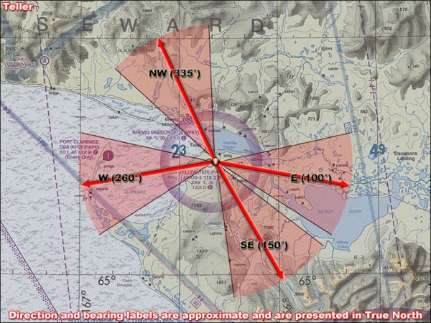
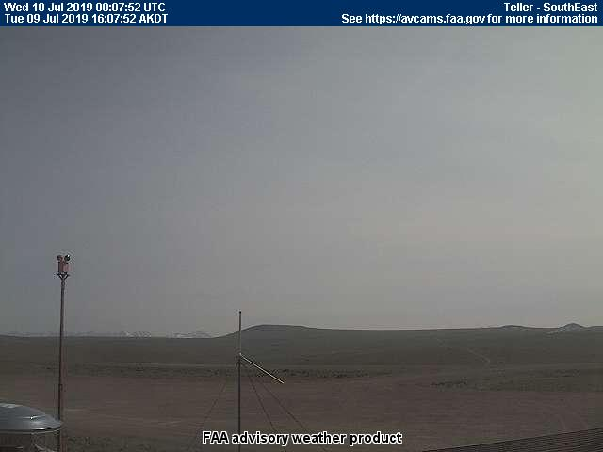
9 July 2019/DOY 190 Seward Peninsula Revisit
Leg 2
Teller (TER) – 1600 AKDT/0000 UTC
Northwest
East
West
Southeast
Notes:
Haze seen in the eastern images

